Slide 1

Chapter 7 – S10
How to work with
numbers, strings, and dates
Notes:
Session: Ghi số thứ tự session trong môn học
Session Name: ghi tên của session sẽ dạy

Slide 2
Objectives
How to work with numbers
The PIG application
How to work with strings
How to work with dates and times
The Count Down application
Notes:
Mô tả nội dung mà học viên phải đạt được khi kết thúc môn học này

Slide 3
How to work with numbers
Notes:
Session: Ghi số thứ tự session trong môn học
Session Name: ghi tên của session sẽ dạy

Slide 4
How to use the properties and methods of the Number object
JavaScript use Number and Math object to provide the properties and methods to working with number.
Properties of the Number object
Property | Shortcut | Description
Number.MAX_VALUE |  | The largest positive value that can be represented.
Number.MIN_VALUE |  | The smallest positive value that can be represented.
Number.POSITIVE_INFINITY | Infinity | Represents positive infinity
Number.NEGATIVE_INFINITY | Infinity | Represents negative infinity
Number.NaN | NaN | Represents a value that isn’t a number

Slide 5
How to use the properties and methods of the Number object (cont.)
Example 1: Testing for Infinity, - Infinity and NaN
If(result == Infinity){
alert(“The result exceeds ” + Number.MAX_VALUE);
}else if (result == -Infinity){
alert(“The result is below ” + Number.MIN_VALUE);
}else if(isNaN(result)){
alert(“The result is not a number ”);
}else {alert(“The result is” + result);}
Example 2: Division by zero
alert(0/0); //Display NaN
alert(10/0); //Display Infinity

Slide 6
Methods of the Number object
Example 3: Using the toFixed() method
var subtotal = 19.99, rate = 0.075;
var tax = subtotal * rate; //tax is 1.49925
tax = parseFloat(tax.toFixed(2)); //tax is 1.5
alert(tax.toFixed(2)); //display 1.50
Example 4: Implicit use of the toString() method for base 10 conversions
var age = parseInt(prompt(“Please enter your age.”));
alert(“Your age is ” + age);
Method | Description
toFixed(digits) | Returns a string with the number rounded to the specified decimal digits.
toString(base) | Returns a string with the number in the give base. If basic is omitted, 10 is used.

Slide 7
How to use the properties and methods of the Math object
One property of the Math object
Example 1: The PI property
var area = Math.PI * 3 *3;
Property | Description
Math.PI | Returns 3.141592.., which is the radio of the circumference of a circle to its diameter.

Slide 8
How to use the properties and methods of the Math object(cont.)
Common methods of the Math object
Method | Description
Math.abs(x) | Returns the absolute value of x.
Math.round(s) | Returns the value of x rounded to the closest integer value.
Math.ceil(x) | Returns the value of x rounded to the next higher integer value.
Math.floor(x) | Returns the value of x rounded to the next lower integer value.
Math.pow(x,power) | Returns the value of x raised to the power specified.
Math.sqrt(x) | Return the square root of x.
Math.max(x1,x2,…) | Returns the largest value from its parameters.
Math.min(x1,x2,…) | Returns the smallest value from its parameters.

Slide 9
How to use the properties and methods of the Math object(cont.)
Example: The abs() method
var result_2a = Math.abs(-3.4);
Example: The round() method
var result_3a = Math.round(12.5);
var result_3b = Math.round(-3.4);
Example: The floor() and ceil() methods
var result_4a = Math.floor(12.5); //Return 12
var result_4b = Math.ceil(12.5); //Return 13
var result_4c = Math.floor(-3.4); //Return -3
var result_4d = Math.ceil(-3.4); //Return -4

Slide 10
How to use the properties and methods of the Math object(cont.)
Example: The pow() and sqrt() methods
var result_5a = Math.pow(2,3);
var result_5b = Math.pow(125,1/3);
var result_5c = Math.sqrt(16);
Example: The min() and max() methods
var x=12.5, y = -3.4;
var max = Math.max(x,y);
var min = Math.min(x,y);

Slide 11
How to generate a random number
The random() method of the Math object
Example 1: Generating a random number
var result = Math.random();
Example 2: A function that generates a random number
var getRandomNumber = function(max){
var random;
if(!isNaN(max)){
random = Math.random();
random = Math.floor(random * max);
random = random + 1;
}
return random;
}
var randomNumber = getRandomNumber(100);
Method | Description
Math.random() | Returns a random decimal number >=0.0 but <1.0

Slide 12
The PIG application
Notes:
Session: Ghi số thứ tự session trong môn học
Session Name: ghi tên của session sẽ dạy

Slide 13
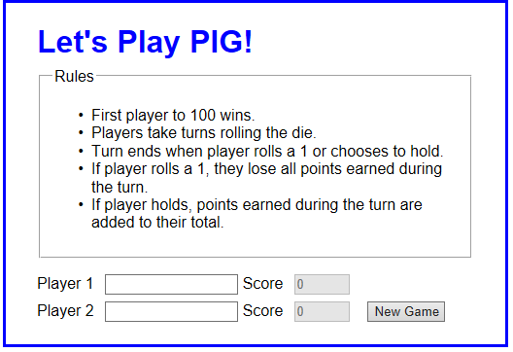
The PIG application
The User Interface

Slide 14
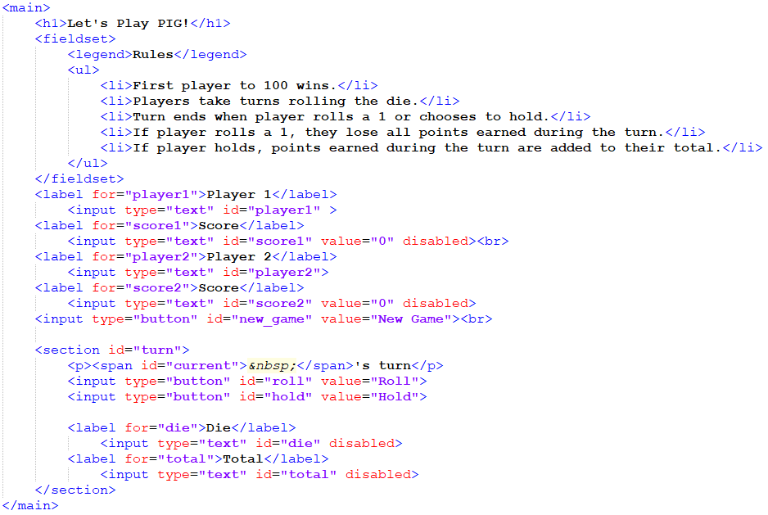
The PIG application
The HTML code

Slide 15
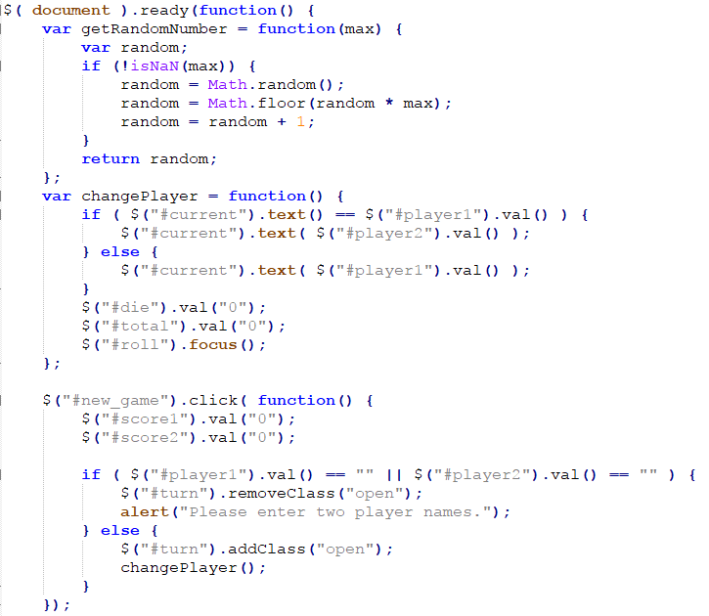
The PIG application
The JavaScript code

Slide 16
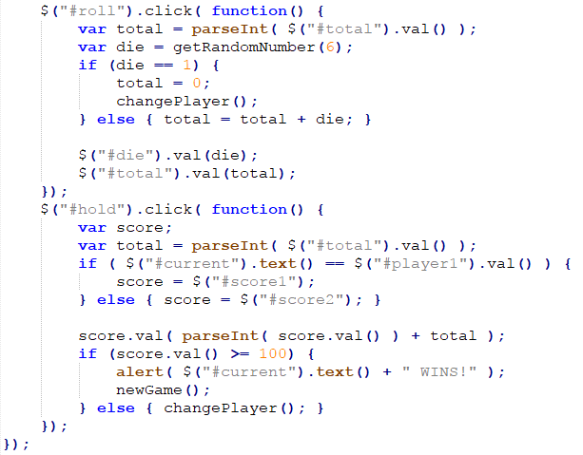
The PIG application
The JavaScript code

Slide 17
How to work with strings
Notes:
Session: Ghi số thứ tự session trong môn học
Session Name: ghi tên của session sẽ dạy

Slide 18
How to use the properties and methods of the String object
JavaScript use String object to work with string.
One property of a String object
Example 1: Displaying the length of a string
var message_1 = “JavaScript”;
var result_1 = message_1.length; //Result_1 is 10
Property | Description
length | The number of characters in the string

Slide 19
How to use the properties and methods of the String object (cont.)
Methods of a String object
Method | Description
charAt(position) | Return the character at the specific position in the string.
concat(string1, string2,…) | Return a new string that concatenation of strings in parameter list.
indexOf(search,start) | Return the position of search string if it occurs. If no -1 is returned.
substr(start,length) | Return the substring with number character in length parameter and from start position.
substring(start) | Return the substring from the start position to end of the string.
substring(start,end) | Return the substring from the start position to but not including the end position.
toLowerCase() | Return the string with lowercase character.
toUpperCase() | Return the string with uppercase character.

Slide 20
How to use the properties and methods of the String object (cont.)
Example 2: The charAt() method
var message_2 = “JavaScript”;
var letter = message_2.charAt(4); //letter is “S”
Example 3: The concat() method
var message_3 = “Java”;
var result_3 = message_3.concat(“Script”); //result_3 is “JavaScript”
Example 4: The indexOf() method
var result_4a = message_2.indexOf(“a”); //result is 1
var result_4b = message_2.indexOf(“a”,2); //result is 3
var result_4c = message_2.indexOf(“s”); //result is -1

Slide 21
How to use the properties and methods of the String object (cont.)
Example 5: The substr() and substring() methods
var result_5a = message_2.substr(4,5); //result is “Scrip”
var result_5b = message_2.subString(4); //result is “Script”
var result_5c = message_2.substring(0.4);//result is “Java”
Example 6: The toLowerCase() and toUppercase() methods
var result_6a = message_2.toLowerCase();
//result is “javascript”
var result_6a = message_2.toUpperCase();
//result is “JAVASCRIPT”

Slide 22
How to work with dates and times
Notes:
Session: Ghi số thứ tự session trong môn học
Session Name: ghi tên của session sẽ dạy

Slide 23
How to create Date objects
How to create a Date object with current date and time
var now = new Date();
How to create a Date object by specifying a date string
var electionDay = new Date(“11/6/2018”);
var grandOpening = new Date(“2/16/2017 8:00”);
var departureTime = new Date(“4/6/2017 18:30:00”);
How to create a Date object by specifying date part
Syntax:
new Date(year,month,day,hours,minutes,seconds,milliseconds)
Example:
var electionDay = new Date(2018,10,6);
var grandOpening = new Date(2017,1,16,8);
var departureTime = new Date(2017,3,6,18,30);

Slide 24
The methods od the Date object
The formatting methods of a Date object
Examples of the formatting methods
var birthday = new Date(2017,0,7,8,25); //Jan 7 2017 8:25am
alert(birthday.toString());
//”Sat Jan 07 2017 08:25:00 GMT +0700”
alert(birthday.toDateString()); //”Sat Jan 07 2017”
alert(birthday.toTimeString()); //”08:25:00 GMT-+0700”
Method | Description
toString() | Returns a string containing the date and time in local time in the local time using the client’s time zone.
toDateString() | Returns a string representing just the date in local time.
toTimeString() | Returns a string representing just the time in local time.

Slide 25
The methods od the Date object (cont.)
The get methods of a Date object
Method | Description
getTime() | Returns the number of milliseconds since midnight, Jan 1, 1970.
getFullYear() | Returns the four-digit year in local time.
getMonth() | Returns month in local time, starting with 0 for January.
getDate() | Returns the day of the month in local time.
getDay() | Returns the day of the week (1=Sunday, 2=Monday…)
getHours() | Returns the hour in 24 hour format.
getMinutes() | Returns the minutes in local time
getSeconds() | Returns the seconds in local time
getMilliseconds() | Returns the milliseconds in local time

Slide 26
The methods od the Date object (cont.)
The set methods of a Date object
Method | Description
setFullYear(year) | Sets the four-digit year in local time.
setMonth(month) | Sets the month in local time.
setDate(day) | Sets the date of the month in local time.
setHours(hour) | Sets the hour in 24-hour format in local time.
setMinutes(minute) | Sets the minutes in local time.
setSeconds(second) | Sets the seconds in local time.
setMilliseconds(ms) | Sets the milliseconds in local time.

Slide 27
Examples of working with dates
Example 1: How to display the date in your own format
var departTime = new Date(2017,3,6,18,30);
var year = departTime.getFullYear();
var month = departTime.getMonth() +1;
var day = departTime.getDate();
var dateText = year + “-”;
if(month<10){
month =“0” + month;
}
dateText = +=month + “-”;
if(day<10){
day = “0” + day;
}
dateText += day +”-”; //dateText is “2017-04-06”

Slide 28
Examples of working with dates (cont.)
Example 2: How to calculate a due date
var invoiceDate = new Date();
var dueDate new Date(invoiceDate);
dueDate.setDate(dueDate.getDate + 21);
Example 3: How to find the end of the month
var endOfMonth = new Date();
//Set the month to next month
endOfMonth.setMonth(endOfMonth.getMonth() + 1);
//Set the date to one day before the start of the month
endOfMonth.setDate(0);

Slide 29
The Count Down application
Notes:
Session: Ghi số thứ tự session trong môn học
Session Name: ghi tên của session sẽ dạy

Slide 30
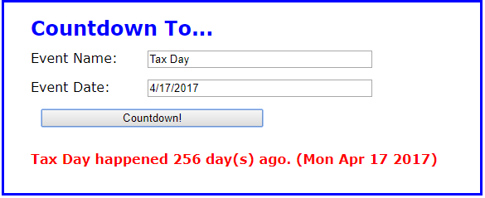
The Count Down application
The User Interface

Slide 31
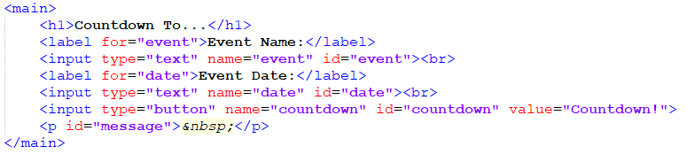
The Count Down application
The HTML code

Slide 32
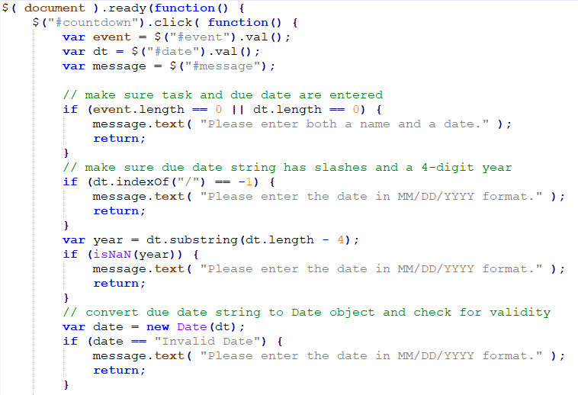
The Count Down application
The JavaScript code

Slide 33
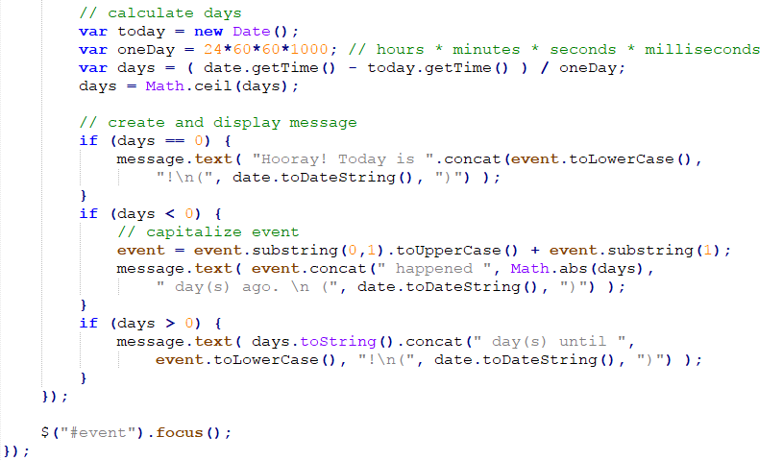
The Count Down application
The JavaScript code

Slide 34
Summary
To working with numeric data, you can use properties and methods of the Number and Math object.
To working with string data, you can use properties and methods of the String object.
In JavaScript, dates are stored in Date objects, and they are represented by the number of milliseconds since midnight, Jan 1, 1970.
Notes:
Tóm tắt lại nội dung đã học

Slide 35
The End.

